Slide 1
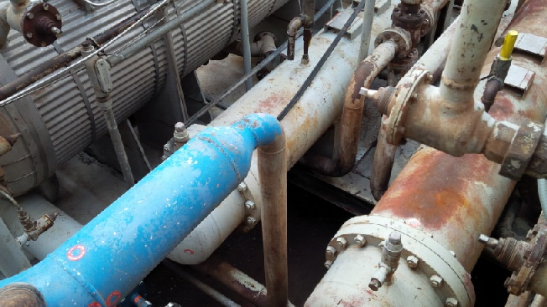
HS&E INCIDENT BULLETIN |  | 1st half year 2014
Snyder (US) | Type of incident: Slip Causing Contact with Equipment
Summary:
Employee was steam cleaning a refrigeration compressor skid, when he slipped in oil while in a tight area and the steam wand became stuck between (lace-up) boot and equipment and employee could not quickly remove it. The employee sustained a burn to the top of the foot requiring medical treatment.
Root Causes: | Actions Taken Thus Far: Next Steps
Process (Conditions) - Inadequate/defective tools/equipment/materials/products. Process (Conditions) - Inadequate hazard identification or risk assessment. | Conduct continual risk assessment retraining with employee. Facilitate a Job Hazard Analysis (JHA) training session with all applicable employees, and competency assessment. Review the activity hazard and risk assessment to identify the potential hazards of the pressure washing task and ensure controls are appropriate to mitigate the hazards.
Area where wand became stuck

Slide 2
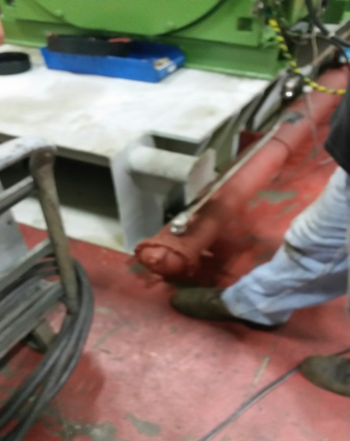
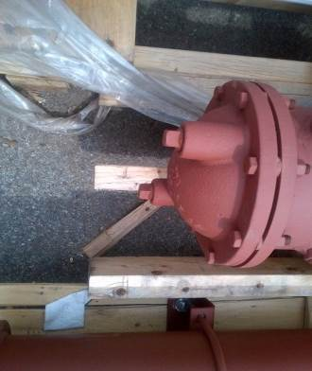
HS&E INCIDENT BULLETIN |  | 1st half year 2014
Buffalo (US) | Type of incident: Contact Against Protruding Equipment
Summary:
Employee was walking on a skid and bumped his lower leg (shin) against a small pipe plug that was sticking out suffering a minor contusion/bruise. Several days later it was determined that the site of the bruise had become infected. The employee was given antibiotics and time away from work.
Root Causes: | Actions Taken Thus Far: Next Steps
People (Acts) - Lack of attention/distracted by other concerns/stress. | Engineering to investigate the pipe plugs currently used on the oil unit to find a substitution with less or no protrusion. Cones to define ends of machines being assembled to alert of possible hazards at the edges (blind corners) of builds in progress. Develop area specific training for hazard awareness and using continual risk assessment process.
¾” square pipe plugs on oil unit cap

Slide 3
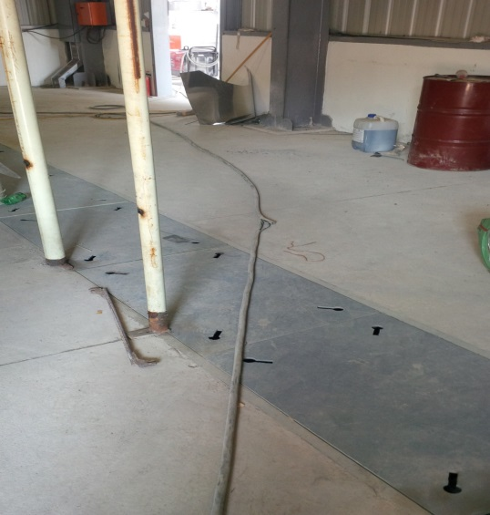
HS&E INCIDENT BULLETIN |  | 1st half year 2014
Buffalo (US) | Type of incident: Trip on Cable at Floor Level
Summary:
Employee inadvertently stepped on a power cable stretched across the floor while on a customers site to commission a compressor. The cable rolled under his right foot and he twisted his ankle, causing a fracture.
Root Causes: | Actions Taken Thus Far: Next Steps
People (Acts) - Improper decision making or lack of judgment. People (Acts) - Lack of attention/distracted by other concerns/stress. Process (Conditions) - Inadequate hazard identification or risk assessment. | Enhanced hazard awareness training for field service technicians. Instruct employee to take five minutes, assess the work area and complete a Step Back 5x5 before, during and at the end of the work day. If there are hazards present either eliminate them or lessen the risk. Instruct field service employees to wear footwear with ankle support whenever possible as long as it does not create a secondary hazard from wet environments etc.
Floor area at customer location

Slide 4
HS&E INCIDENT BULLETIN |  | 1st half year 2014
Buffalo (US) | Type of incident: Fall from Height
Summary: | PHOTO – NOT AVAILABLE
While working at customers site a field service employee stepped off a compressor foundation and twisted his ankle.
Root Causes: | Actions Taken Thus Far: Next Steps
People (Acts) - Improper decision making or lack of judgment. People (Acts) - Work or motion at improper speed. People (Acts) - Lack of attention/distracted by other concerns/stress. Process (Conditions) - Inadequate hazard identification or risk assessment. | Field service employees to complete hazard awareness refresher training. Process change to include hazard awareness sign off sheet before starting a job on field service sites.

Slide 5
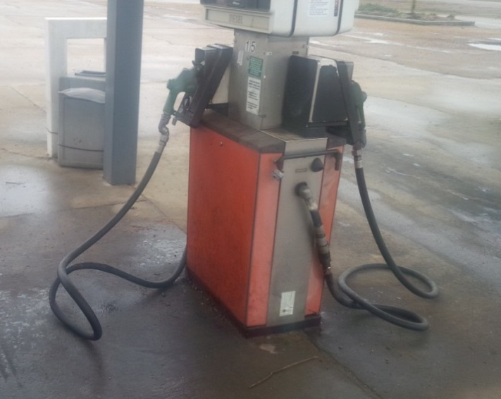
HS&E INCIDENT BULLETIN |  | 1st half year 2014
Salina (US) | Type of incident: Trip and Fall to Floor Level
Summary:
Employee had loaded a company vehicle for work purposes and was about to undertake a return journey to the facility when he stopped to get fuel. While he was fueling the truck he tripped and fell to the ground. He landed on the fuel hose and broke his leg right below the hip.
Root Causes: | Actions Taken Thus Far: Next Steps
People (Acts) - Improper decision making or lack of judgment. Process (Conditions) - Congestion, clutter, or restricted motion. | Develop safe fueling procedure and train all drivers. Develop hazard and risk assessment on driving and include fueling as task. Train all drivers on it and place in each vehicle. Review that all DOT physicals are current.
Gas station and pump area

Slide 6
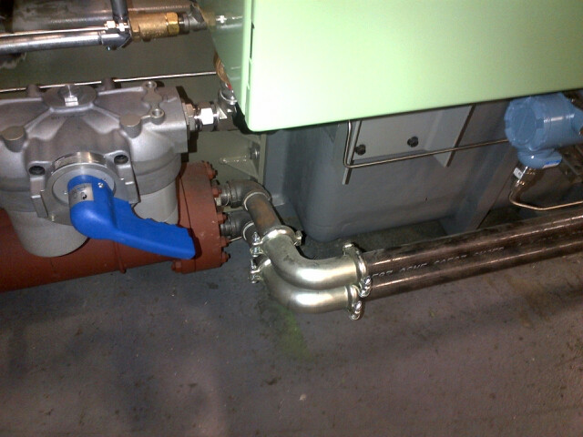
HS&E INCIDENT BULLETIN |  | 1st half year 2014
Buffalo (US) | Type of incident: Overexertion When Using Equipment
Summary:
Employee was tightening a pipe into a elbow on a water manifold assembly when he felt a strain in his right shoulder.
Root Causes: | Actions Taken Thus Far: Next Steps
People (Acts) - Overexertion or improper position/posture for task. Process (Conditions) - Congestion, clutter, or restricted motion. | Ergonomics training: Push not pull to be completed by all employees including field service. Develop and communicate with applicable employees activity hazard and risk assessment for pipe wrench usage. Research the possibility of changing the build sequence to increase working room and use of lift tables.
Control panel creates lack of work room
Elbow installed on pipe

